Slide 1
Macros and Perl Scripts
NVM Bench Program

Slide 2
Macros
Consolidate a list of commands (may include other macros or perl scripts) into a single file that can be executed as a single command.
Benefits
Execution overhead is not significantly greater than entering commands manually on the CLI.
Easy to create. No additional syntax needed.
Drawbacks
No branching or processing capabilities.
Limited flexibility with input parameters.

Slide 3
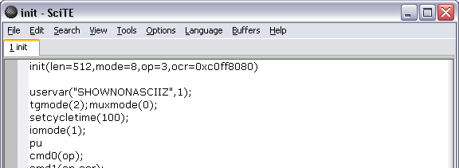
Creating/Editing Macros
Contained in a text file with no extension. The name of the text file will be the identifier used to execute the macro.
The first line of the macro will not be executed. If present, the parentheses enclosed, comma separated list on that line will represent input parameters with default values.
The define command may be used instead of a separate text editor
The first parameter passed to define will be the macro name.
Subsequent parameters, if given, will become parameters of the macro. (Parameters may also be added later in the macro editor).
For example: >define(mymacro,a=1,b=2)
Default value
Parameter name
Parameter usage in macro

Slide 4
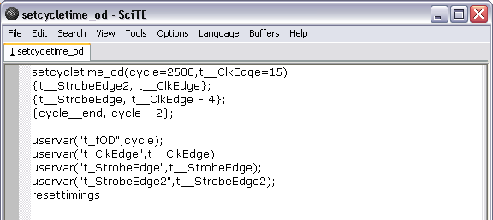
Creating/Editing Macros
Limited math may be used to create new variables by separating the new variable name and its calculation by a comma and enclosing the expression in braces. See next bullet for supported math operations.
Calculation
New variable
New variable usage

Slide 5
Creating/Editing Macros
Supported Math operations:
“+” - Plus
“-” - Minus
“*” - Multiply
“/” - Divide
“%” - Modulus
“^” - Power
“&” - Bitwise AND
“|” - Bitwise OR
“>>” - Bitwise shift right
“<<“ - Bitwise shift left
‘~’ - Bitwise NOT
“||” - Bitwise XOR

Slide 6
Executing macros
Executed from the current macros directory
On program load, defaults to the macros subdirectory of the directory containing the program executable.
May be changed with the setpath command: >setpath(macros,y:\Micron\Nextest\programs\NAND_Media\macros\justinhunter)
May be retrieved with the getpath command: >getpath(macros)
Executed by typing the name of the macro, followed by a parameter list
Parameters not given will be set to the default value in the macro definition.
For example: >init(,4)

Slide 7
Scripts
Allow CLI command lines to be executed in the context of an independent script process
Benefits
Maximum flexibility: user interactivity, branching, processing, output.
Drawbacks
Extra overhead involved between each command line executed.
Must understand perl syntax and scripting techniques.

Slide 8
Creating/Editing Scripts
Contained in a text file with a .pl or .tk extension. The .tk extension indicates that the TK module is used to provide a GUI.
Relative paths should be used to locate modules and support files.
Makes scripts robust for multiple sites and systems as shared drive letters and paths may differ.
http://nvmbench/User%20Guides/Nextest_individual_login_advanced_topics.htm
The runcli module should be included to facilitate executing commands on the CLI and processing output.

Slide 9
Creating/Editing Scripts
Scripts should be edited on host PC
May use any text editor. SciTE can be launched from desktop.
The edit command may also be used to launch SciTE with the script name (including the file extension) as the first parameter.
For example: >edit(setcycletime.pl)
May need to set the path for SciTE.exe if running a program from a debug location (vs. the standard locations used by the launcher).
Use the setpath command: >setpath(wscite,y:\micron\nextest\wscite)

Slide 10
Using runcli – Input Parameters
Use runcli.pm to process input parameters and provide ‘?’ help
use runcli; #imports RunCli(), GetCliResult(), InputArgs(), and OutputCli()
my $local_arg1;
...
InputArgs(
'?' => "Overall Description",
'arg1' => {
'?' => "arg1 description",
'DEF' => $arg1_default_value,
'VAR' => \$local_arg1
},
'arg2' => {
…
},
);
InputArgs() will output help and exit if the first parameter was ‘?’
Otherwise, parameter values will be assigned to given references ($local_arg1 above)

Slide 11
Using runcli – Execute Commands
Use runcli.pm to execute commands and process the output from those commands
use runcli; #imports RunCli(), GetCliResult(), InputArgs(), and OutputCli()
my @CLIResults;
...
RunCli("pu;rst;rs”);
my ($status) = GetCliResult(qr/Status\s*=\s*0x([A-F0-9]+)/);
for (my $step = 0; $step <= $maxstep; $step++)
{
@CLIResults = RunCli("somecommand($step)");
...
}
GetCliResult returns an array of all matched capture expressions from the output
Applies only to the most recently executed RunCli()
RunCli returns an array of all output lines

Slide 12
Using runcli – Display Output
Use runcli.pm to display output messages on the program’s command line window
A trailing newline is implicit in each OutputCli().
A leading newline should be given explicitly once before any other output.
use runcli; #imports RunCli(), GetCliResult(), InputArgs(), and OutputCli()
...
OutputCli(""); #Ensure text output begins on a new line
OutputCli("This is a multi-line string.\n".
"\tIndentation with \\t or spaces is allowed.");
...
OutputCli("Future lines do not need an explicit leading newline");
Use standard print() function to display output messages in perl’s command prompt window
Mostly useful for debug. May need to insert <STDIN> to allow reading before the script exits.
print ("DEBUG: var = $var\nPress enter..."); <STDIN>;

Slide 13
Executing Scripts
Text on/off
Text is on by default, but usually it should be turned off prior to executing scripts
Suppresses command output from being printed to the command line window
>text(off)
Executing scripts from the program’s command line window
>testscript(?)
>testscript(3)
Script path
Default
scripts directory within program root
Maverick: network share
Magnum: local drive synchronized with network share by launcher
Manual setting/getting
>setpath(scripts,I:\Micron\Nextest\programs\Genesi_TC\scripts)
>getpath(scripts)
Notes:
Executing a script with ‘?’ as the first parameter prints out the help text, if the script is build using the InputArgs() function as described on the prior slide “Using runcli – Input Parameters”. For this to print out in a readable fashion requires that text be turned off prior to executing the script.
Scripts may also be executed from a command prompt or from SCiTE debugger window.

Slide 14
Sharing Scripts Across Micron Sites
Directory organization and mirroring
Directories mirrored
scripts, macros, patterns: root plus special subdirectories
Example of special subdirectory: scripts\GF
Mirrored conservatively from Boise server (\\bofs13\flash) to all sites requesting a particular program
Discussion on making script paths multi-site friendly
http://nvmbench/User%20Guides/Nextest_individual_login_advanced_topics.htm

